Slide 1


HRS: Plate Settlers
High Rate Sedimentation
Determining a method to increase longevity and stability of the floc blanket with implementation of plate settlers
Research | Symposiums Spring 2019
Notes:
We are the plate-settlers half of the high rate sedimentation subteam. Several past subteams have looked into the process of sedimentation and the properties of floc blankets.
ABSTRACT:
Previous High Rate Sedimentation (HRS) teams have observed that the floc blanket is denser at the top versus the bottom of the recirculator at higher upflow velocities. This inconsistency in the floc blanket led former subteams to take multiple calculated approaches in attempts to improve floc blanket longevity and increase overall reactor performance. The Spring 2019 team has worked to replace old tubing and clean the laboratory sedimentation tank. The team is also in the process of designing and incorporating plate settlers within the sedimentation tank to determine whether doing so will improve floc blanket longevity. In the future, the team will explore the effects of varied plate orientation at various upflow velocities.
https://github.com/AguaClara/HRS-Flow-Recycle/blob/master/HRS%20Plate%20Settlers%20Report%20One.md

Slide 2
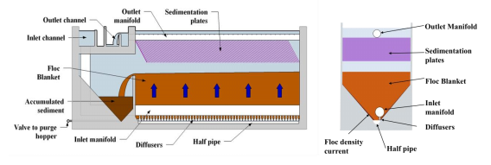
Sedimentation Tank Model
Figure 1: Side-by-side of plant sedimentation tank and lab model
HRS: Plate Settlers | Research | Symposiums Presentation Spring 2019
Notes:
Leena
Figure 1:
Pictured here is the sedimentation setup in an actual AguaClara plant compared to our sed tank setup in lab. The AguaClara sedimentation tank has three main sections. The water flows through the manifold diffusers and up through the floc blanket, which is a concentrated, stabilized, suspended bed of flocculated particles with a relatively clear effluent layer above.
In order to maintain equilibrium as more particles enter through the manifold, flocs at the top of the blanket overflow into the floc hopper or floc weir. The smallest particles which make it past the floc blanket and floc hopper then enter the plate settlers. Plate settlers catch the smallest particles by increasing the horizontal space where particles can settle out. Plate settler length and width determines capture velocity, the lowest velocity at which plates can catch particles.
In our model, this process is represented by the vertical PVC pipe. The floc weir is welded onto the recirculator, and the tube settler is connected to the recirculator by several compression fittings.

Slide 3
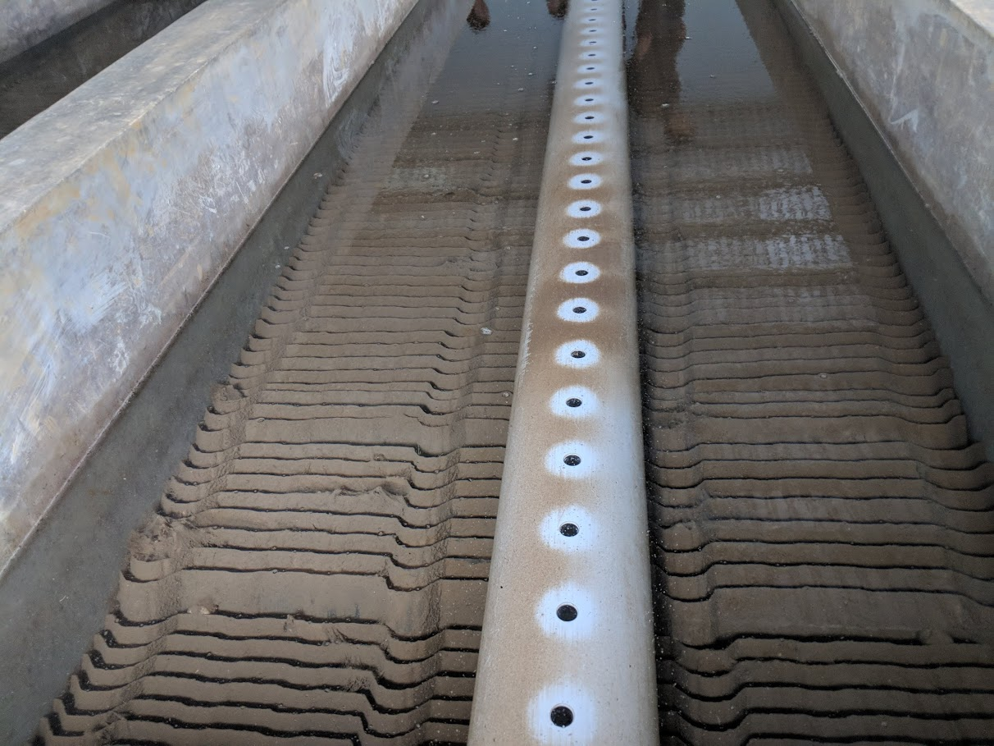
High Rate Sedimentation
Overall goals:
Increase flow rate
Decrease tank size
Lower effective cost
Worse performance at higher upflow velocities
Figure 2: Picture from a plant in Las Vegas, Honduras
HRS: Plate Settlers | Research | Symposiums Presentation Spring 2019
Notes:
Once again, this photo on the right is an image of the plate settlers at a full AguaClara plant in Las Vegas, Honduras.
As you can see from the previous slide as well, sedimentation tanks are large, and therefore the process is slow. The HRS team’s goal has been to increase flow rate, decrease tank size, and lower effective cost for a few years. Thus, our team aims to design a tank that will maintain high upflow velocity while yielding an effluent of no more than 0.3 NTU. This higher upflow velocity will allow for greater water processing, as well as a shorter time period to process the water, which will in turn contribute to lower operating costs.
HRS Plate Settlers hopes to approach this goal by incorporating plate settlers, composed of PVC plates, in the sedimentation tank that was constructed and studied by previous graduate students Matt Hurst and Casey Garland. Our hopes are that incorporating these plate settlers will allow a greater surface area upon which flocs may settle on.
A video of floc blanket formation can be found in the appendix slides.

Slide 4
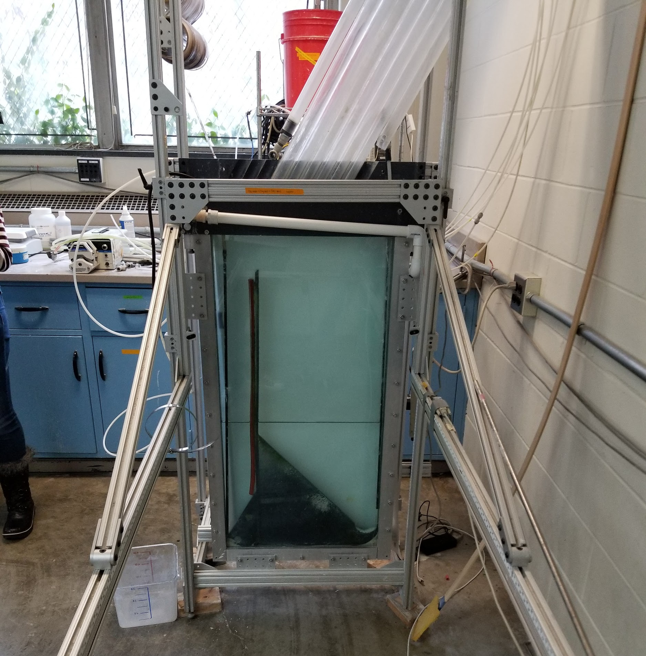
Previous Work on HRS
Matt Hurst
Gives the team controlled variables
Casey Garland
Floc characteristics
Velocity gradient verses resident time
Summer 2018 Team
Recycle Line
HRS: Flow Recycle (Fall 2018)
Following the path of research
Figure 3: Matt Hurst’s, and by extension, Casey Garland’s testing design
HRS: Plate Settlers | Research | Symposiums Presentation Spring 2019
Notes:
Much of the Plate Settlers’ team’s work thus far has been to understand the system with which we are working. Matt Hurst, a former graduate student who worked on AguaClara technologies, showed in 2016 that alum dosage could affect the creation of floc blankets in addition to pace of upflow velocity. Thus, Plate Settlers is keeping in mind the possibility of eventually considering velocity and dose together. Hurst suggested a range of 1.0 to 7.5 mg/L of alum-- these values will be taken into account in our predictive model of the plate settlers.
Casey Garland, another graduate student, closely studied characteristics of the flocs and the floc blanket in this sedimentation setup and the relationship between velocity gradient and resident time. Garland saw that increasing velocity gradients may decrease time required for flocculation.
The Summer 2018 HRS team saw that at higher upflow velocities, the floc blanket was far denser at the top of the recirculator versus at the bottom in the laboratory setup. Thus, the Fall 2018 HRS team was encouraged to build a recycle line from the top to the bottom of the recirculator to improve floc blanket longevity. However, this showed to be ineffective, as installation of a recycle line resulted in decreased reactor performance and effluent turbidity resulted in a consistent ~30 NTU increase versus the baseline trial throughout tests. Water also tended to flow up both the recirculator and the recycle line rather than down the recycle line.

Slide 5
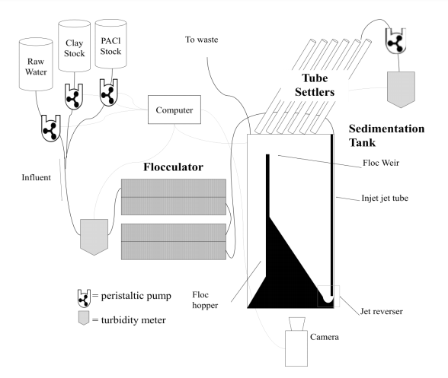
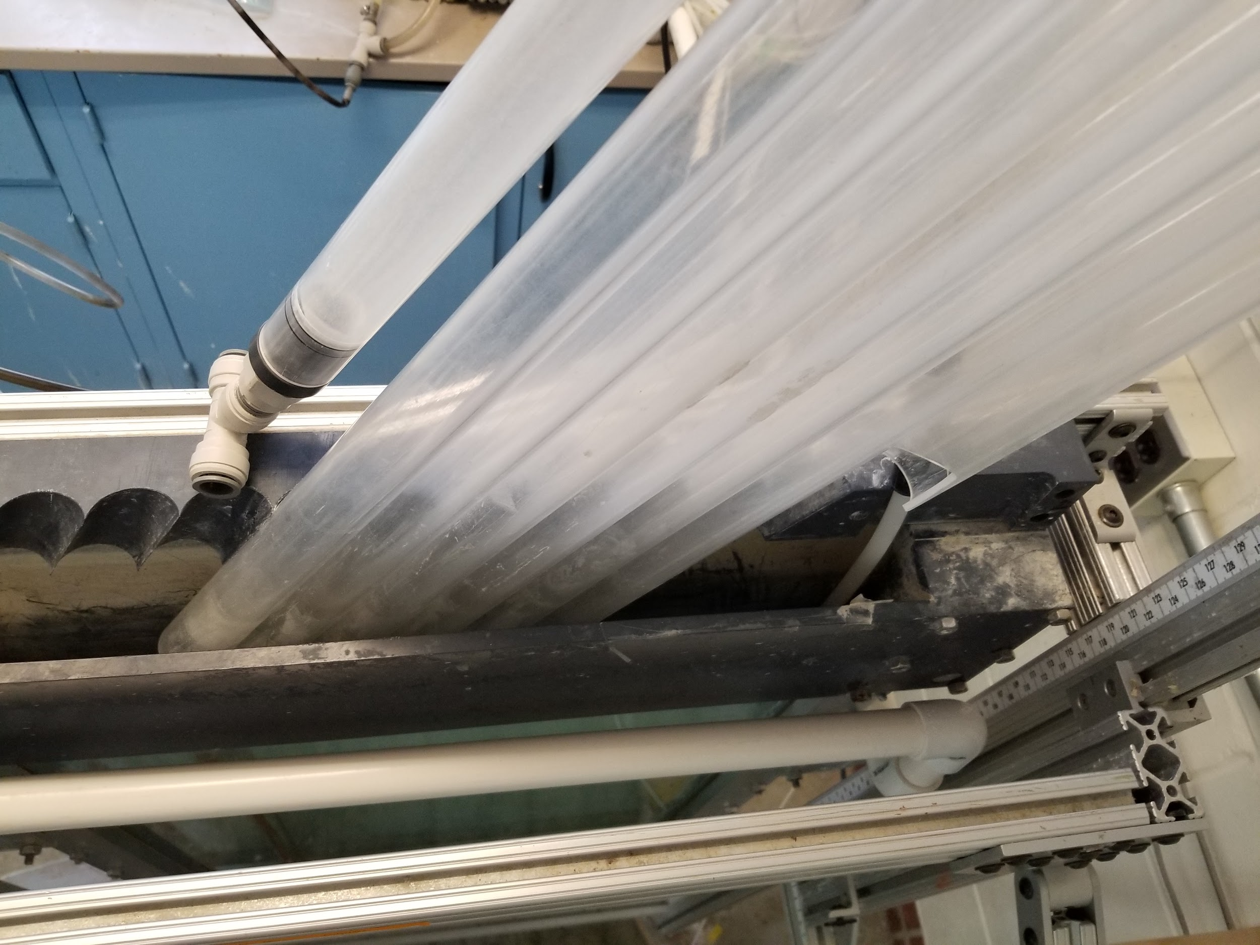
Previous Work on HRS
Figure 5: Tube Settlers
Figure 4: Design schematic of experimental apparatus (Garland (2017))
HRS: Plate Settlers | Research | Symposiums Presentation Spring 2019

Slide 6
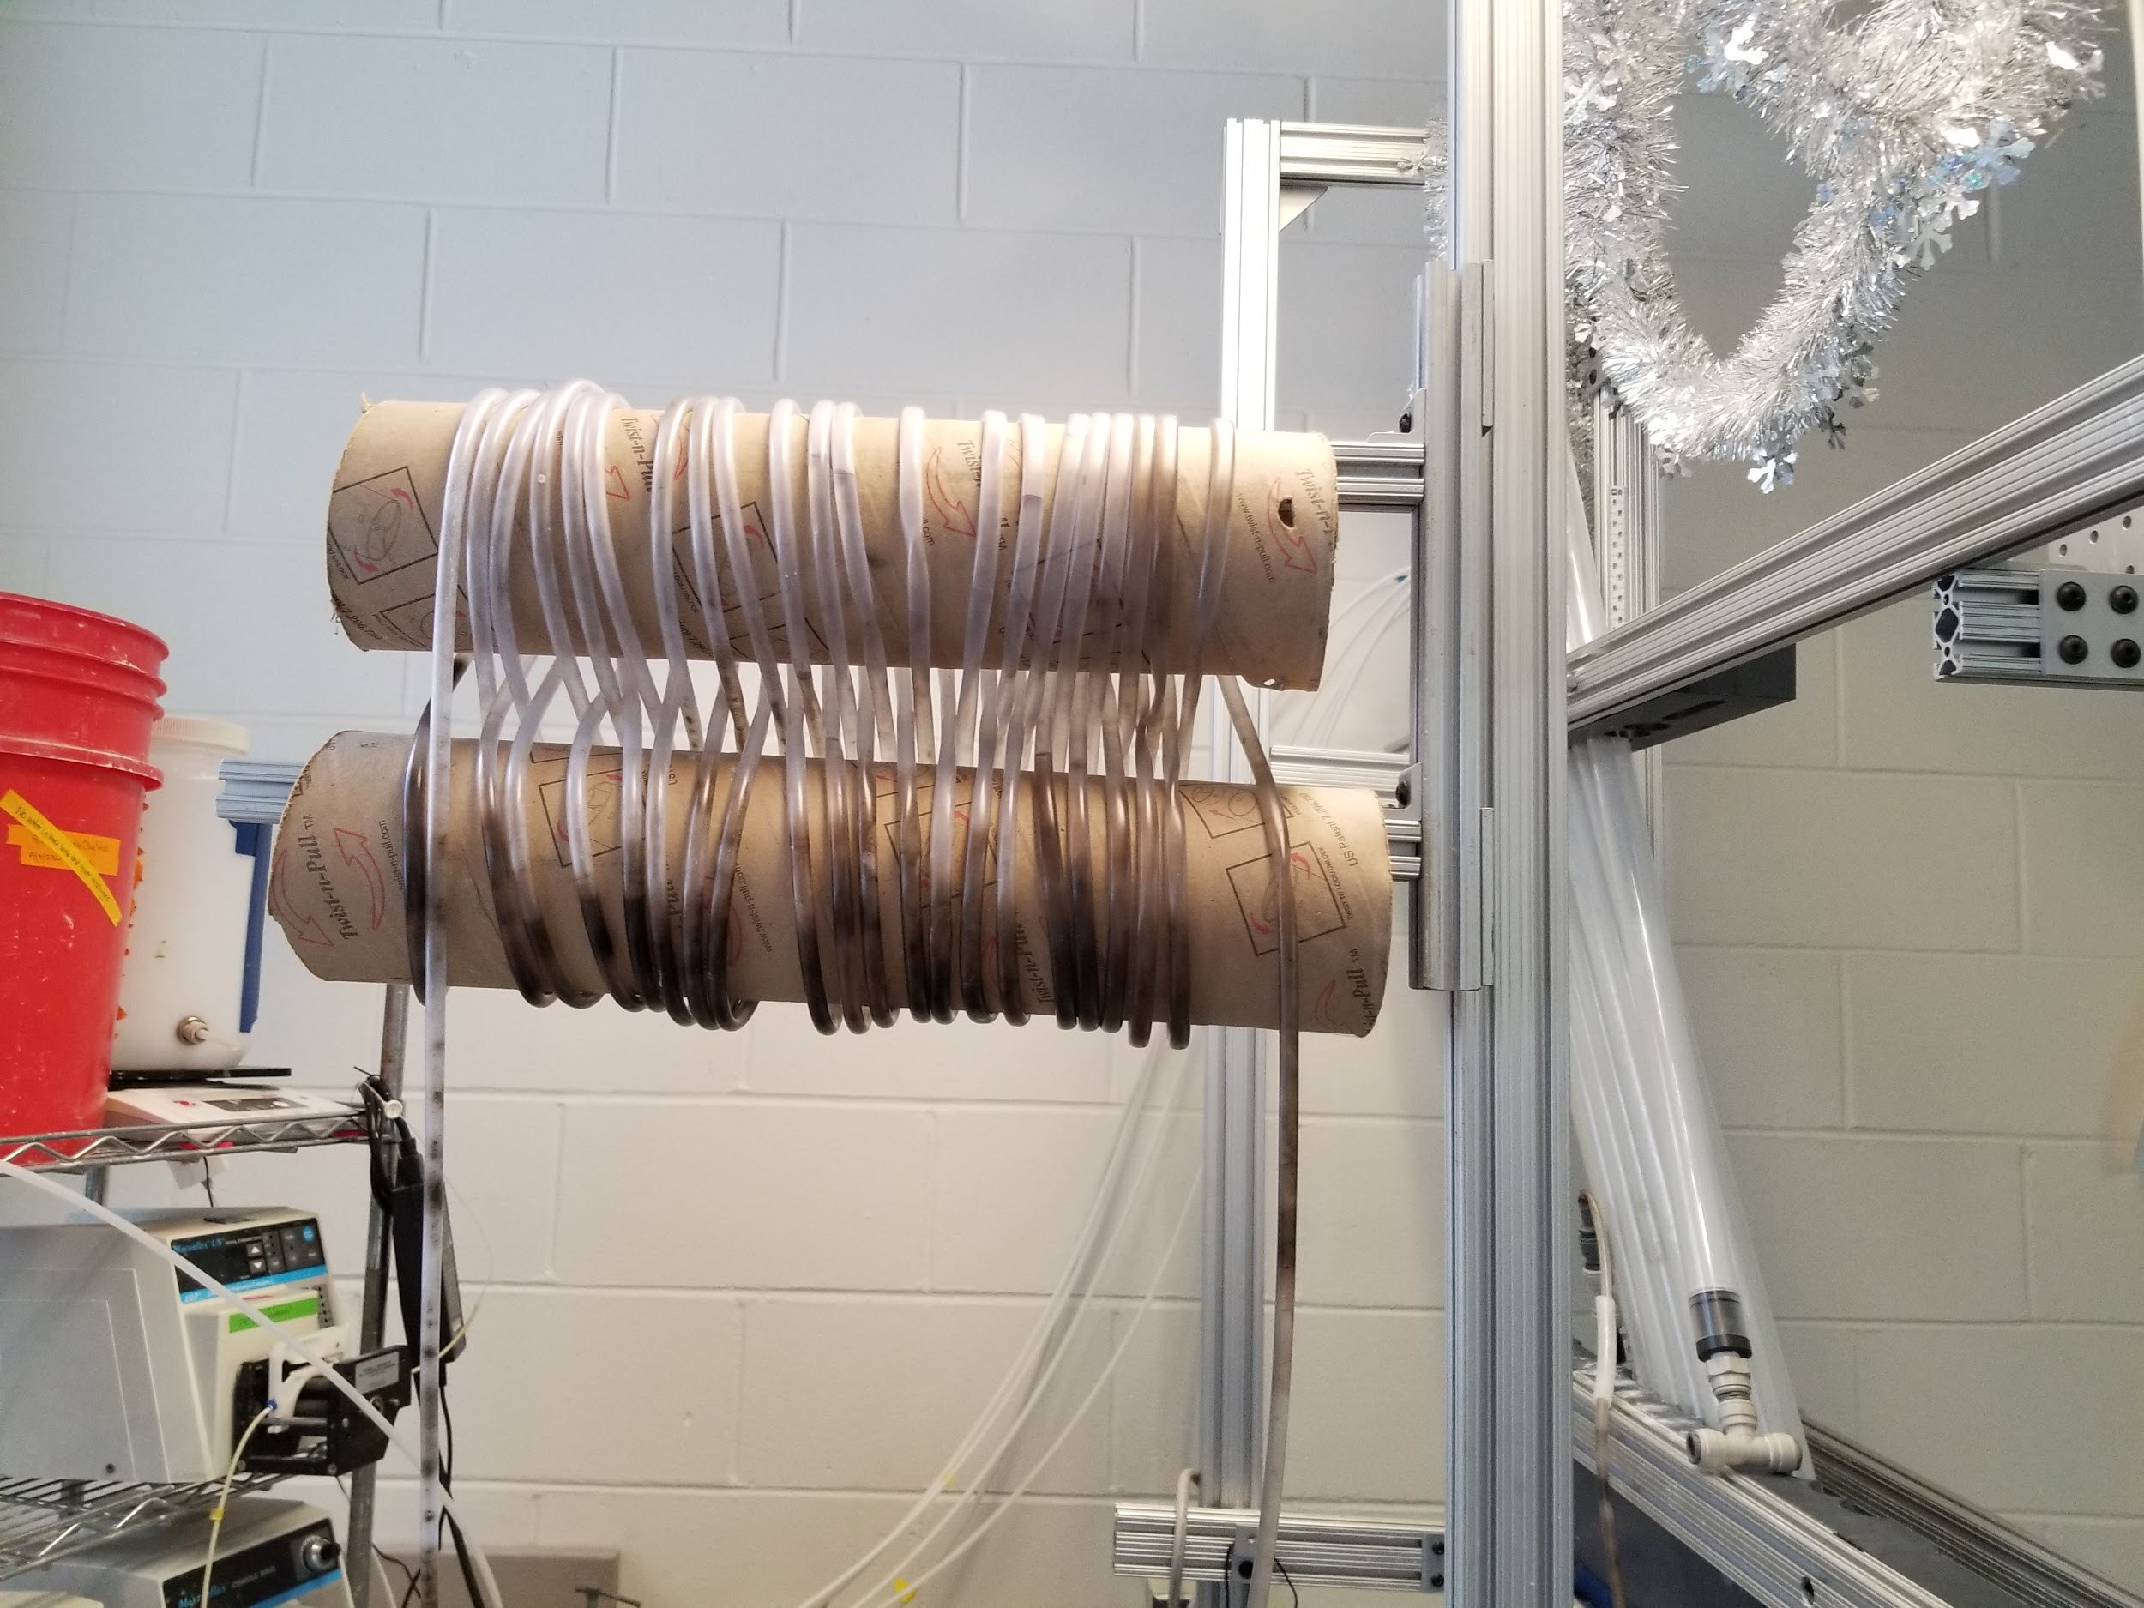

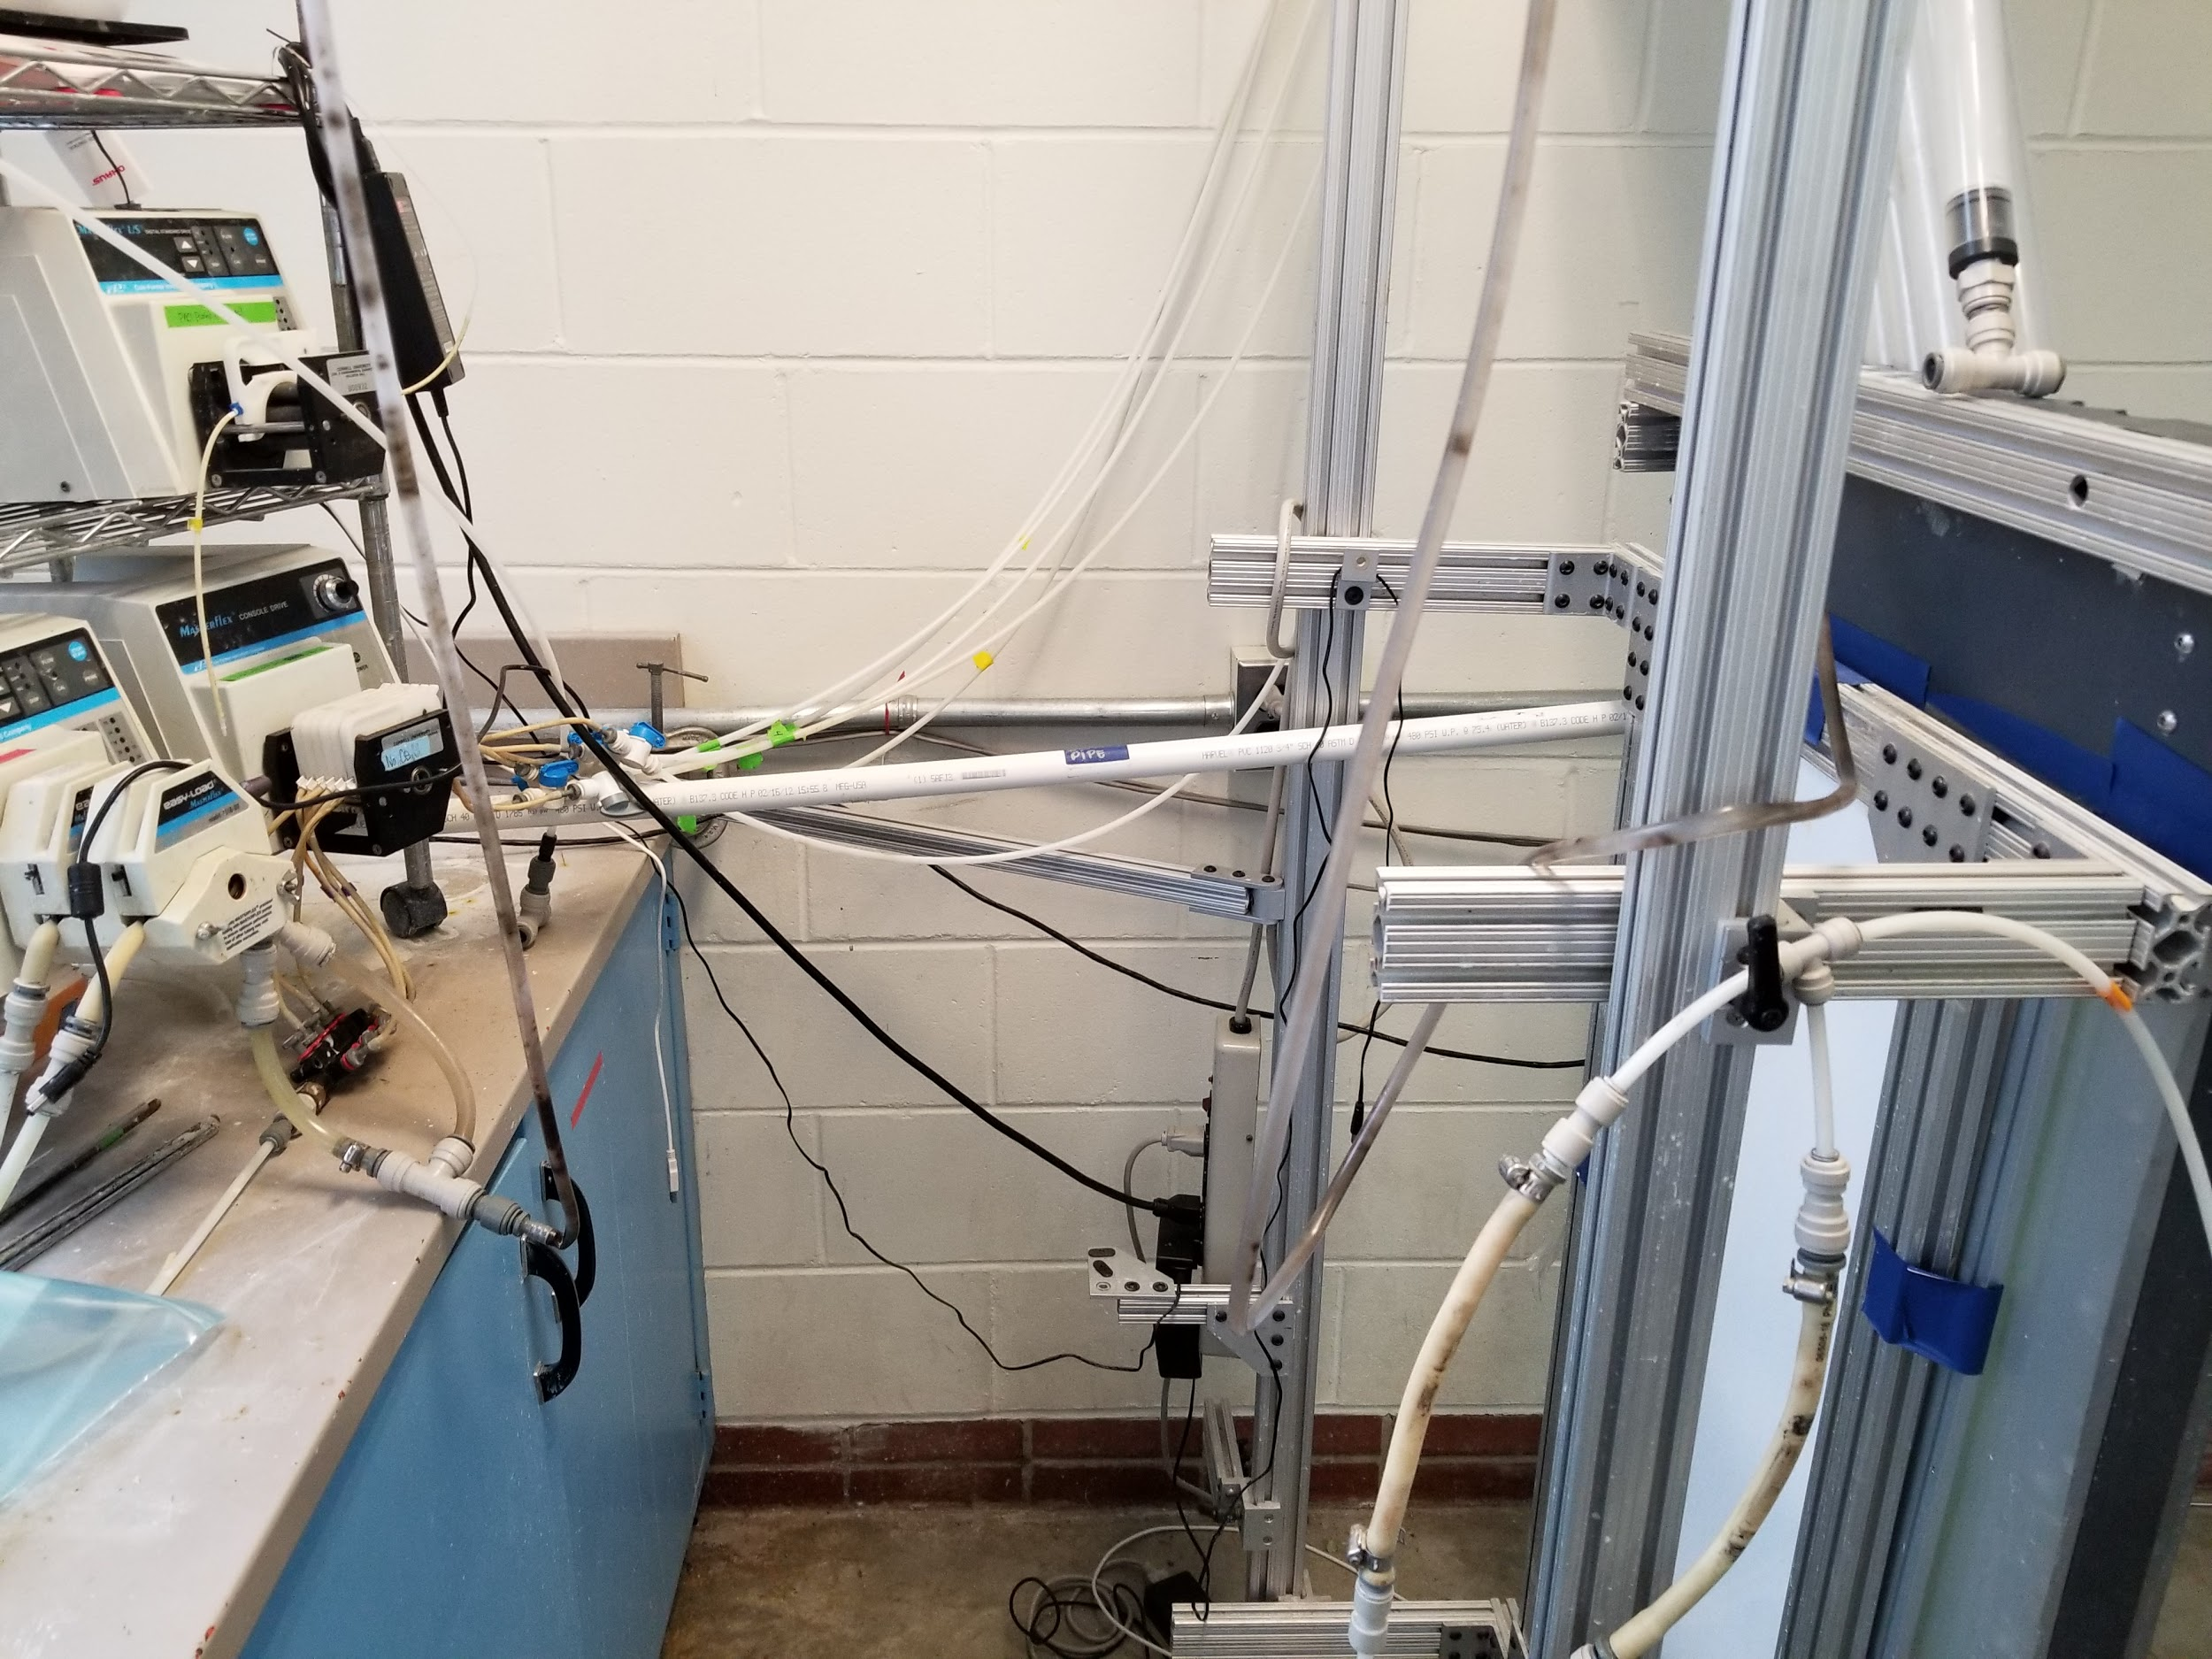
Sedimentation tank
Figure 6: Flocculator
Figure 7: Connection from the sed tank to the pumps
Figure 8: Sedimentation tank model
Notes:
As mentioned before, this is the sedimentation tank that we are working with in the lab. It is basically a scaled down model of the sedimentation tanks found in the AguaClara plants.
The jet reverser: it’s a small tube located at the right, that’s where the water first enters the tank, it’s placement is very important because it helps get rid of the flocs that are settled at the bottom of the tank and it puts them in suspension again.
The plate settlers: or in this case, tube settlers, are a series of tubes that are connected to a pump. That’s where the clean water would be coming out from. They are really useful because they help create the floc blanket. The way they work is, when the water is flowing through them, if that water contains any flocs, these flocs will settle in the tube and slowly slide back into the tank.
The flocculator: water flows through it before going into the tank, simulates what a real flocculator would do in the tanks.
Behind the tank we can see how everything connects to the pumps and the computer.

Slide 7
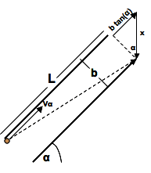
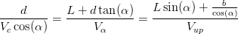
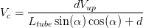
Goals & Plate Settler Theory
In lab goals:
Cleaning and baseline tests
Modeling a plate settler insert
How Plate Settlers work:
capture velocity
Figure 6. Longest possible path of a floc through a sedimentation tube
HRS: Plate Settlers | Research | Symposiums Presentation Spring 2019
Notes:
A common parameter used to describe sedimentation is the capture velocity. Capture velocity is the velocity of the floc that is only barely settled-out, or "captured", during the sedimentation process. To gain a more profound understanding of this crucial parameter, we will walk through the derivation of the capture velocity equation.
The figure below illustrates the longest path that a floc is able to travel in a sedimentation tube and still be captured.
Solving for the capture velocity by equating the first and third expressions, we find that:
Where L is the length of the tube, d is the inner diameter of the tube, Vup is the vertical velocity through one tube, and is equal to sixty degrees.
From the capture velocity equation just derived, it is evident that capture velocity is dependent on the diameter, length, and angle of the tube settlers, as well as the flow rate through the settlers.

Slide 8
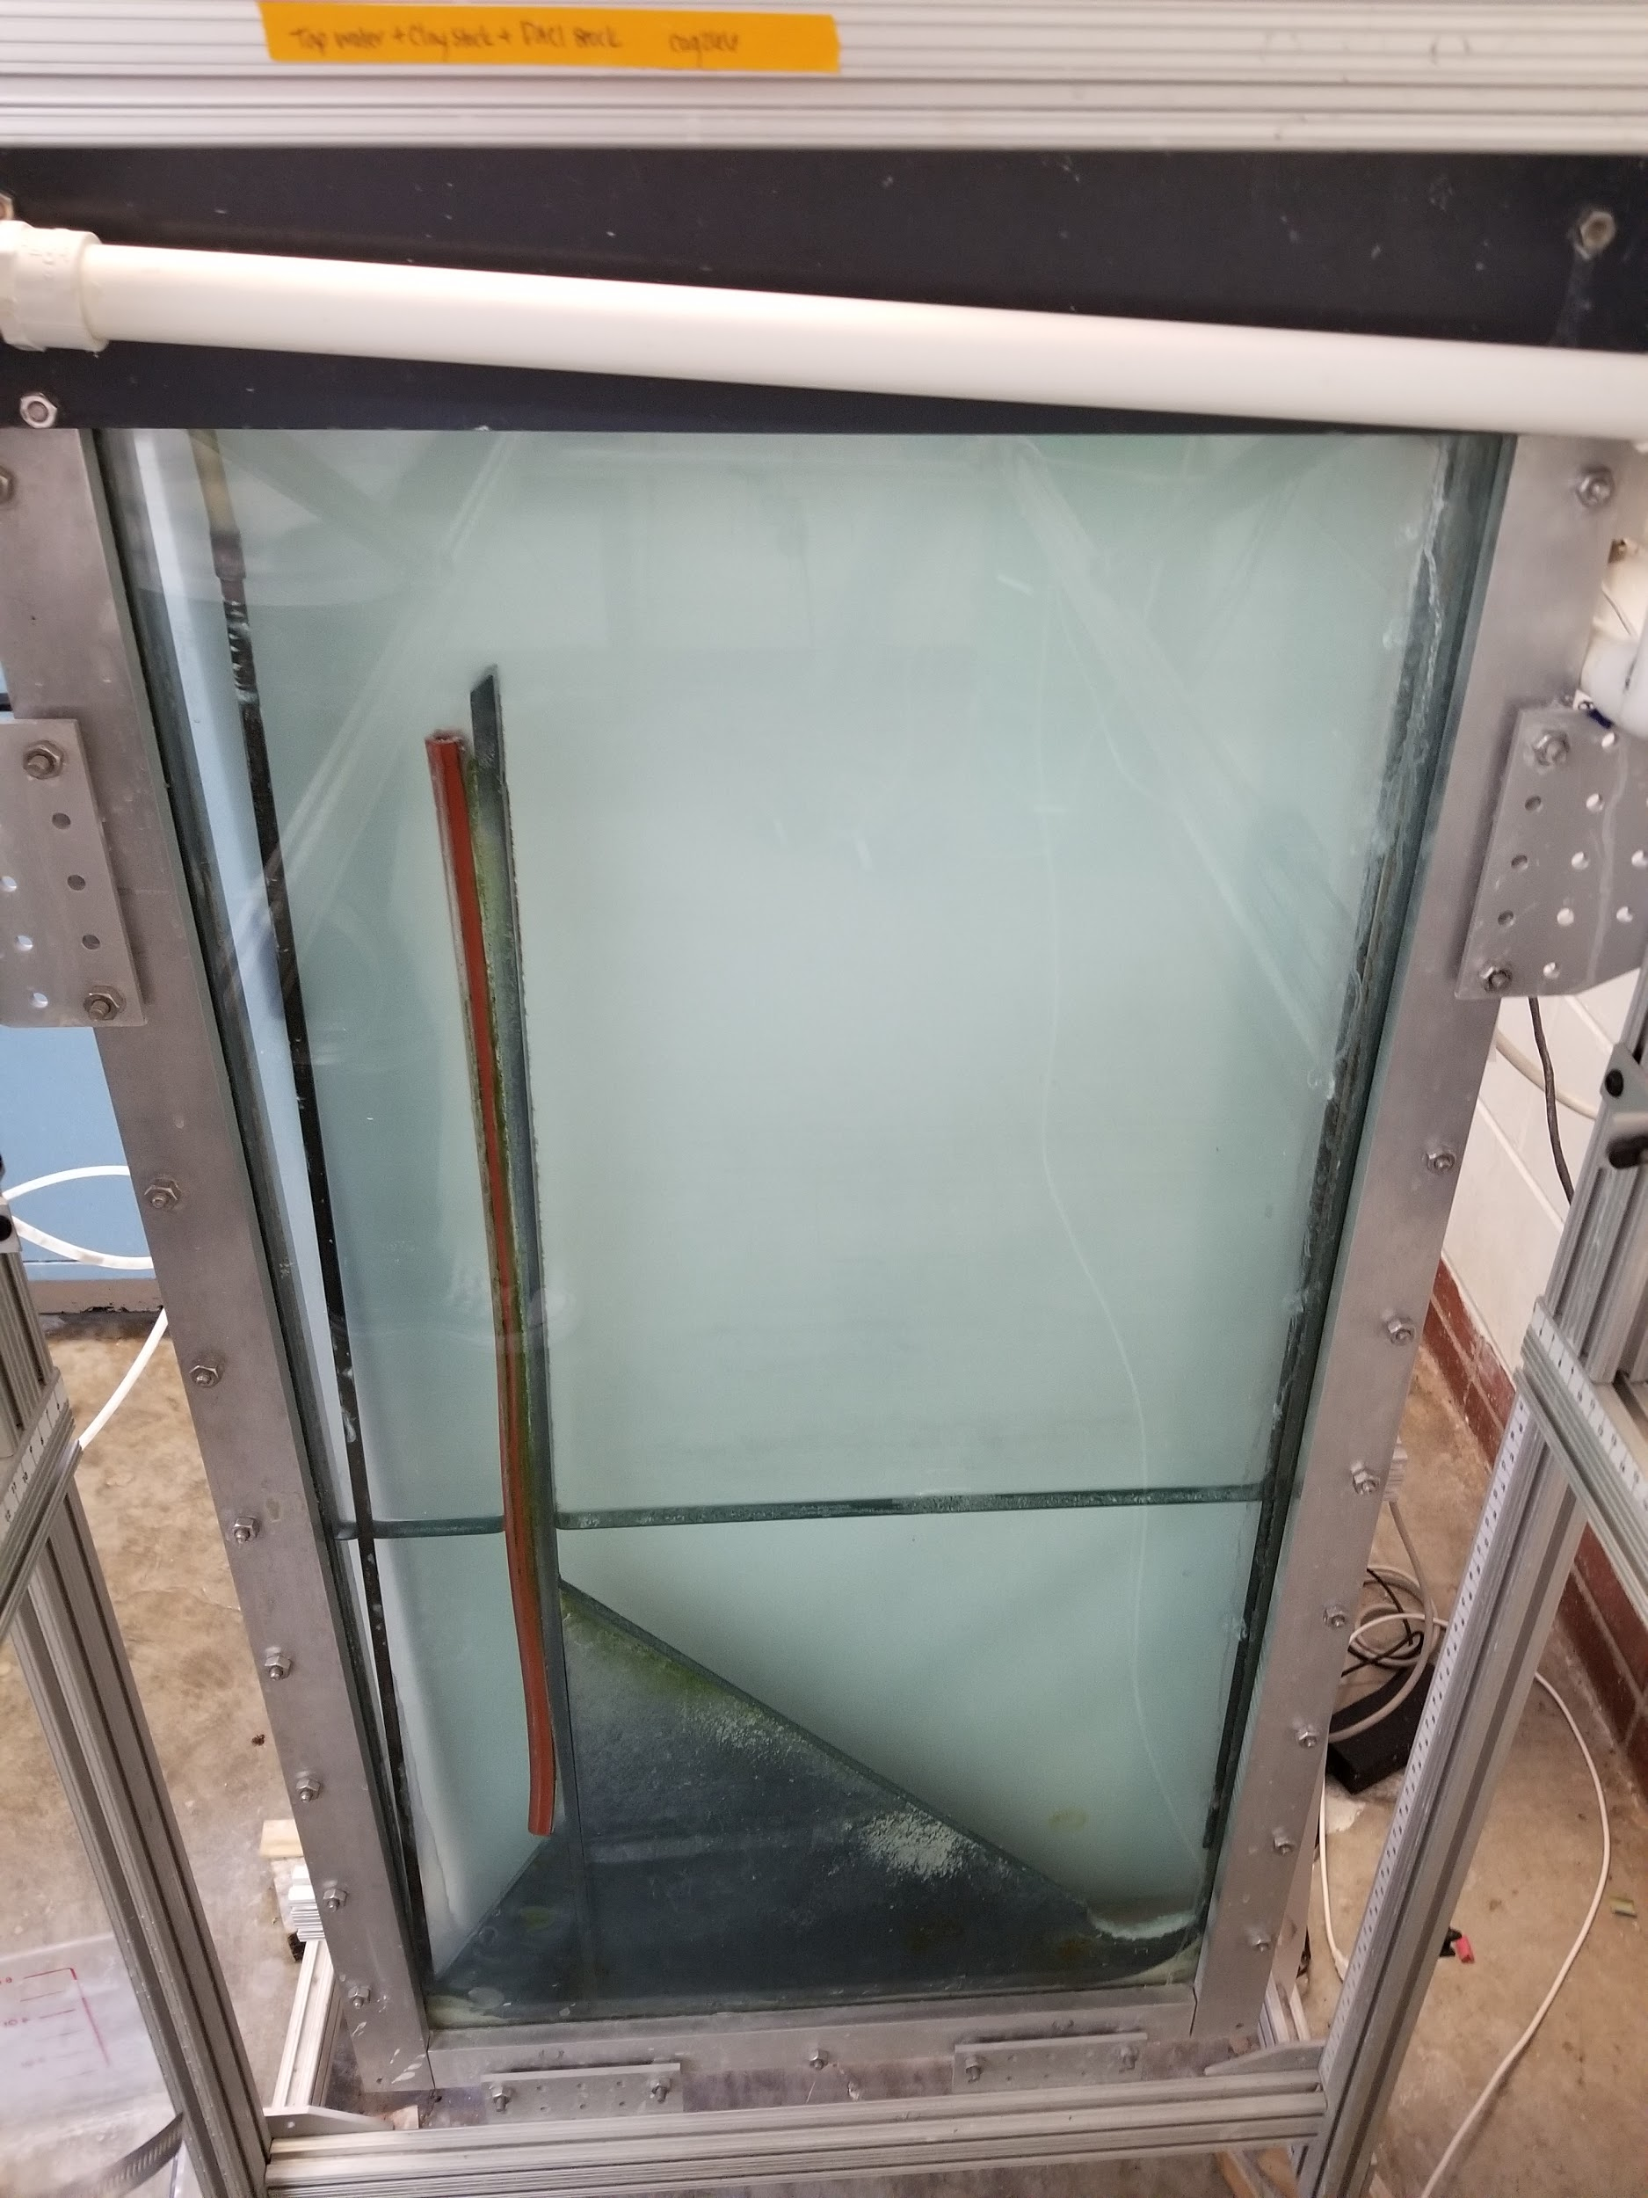
Introducing new plate settlers
Increasing the area where the flocs can settle
Best possible outcome:
Archiving a stabilized floc blanket, equal density of flocs throughout the whole blanket.
Notes:
To achieve our end goal, our main idea was introducing a new row of plate settlers in hopes that by increasing the area where the flocs can settle, the floc blanket will be more stabilized. Meaning that all the flocs will be equally distributed in the tank.

Slide 9
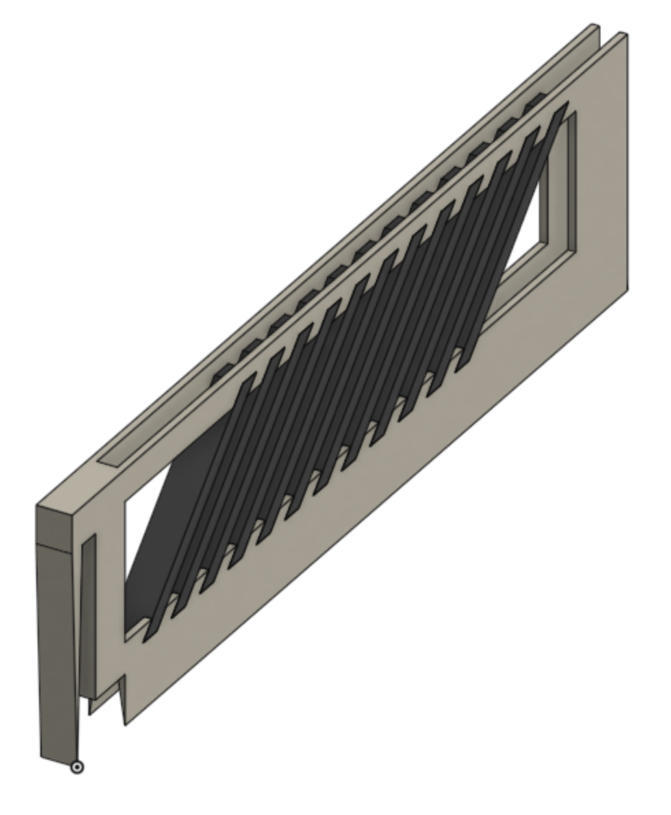
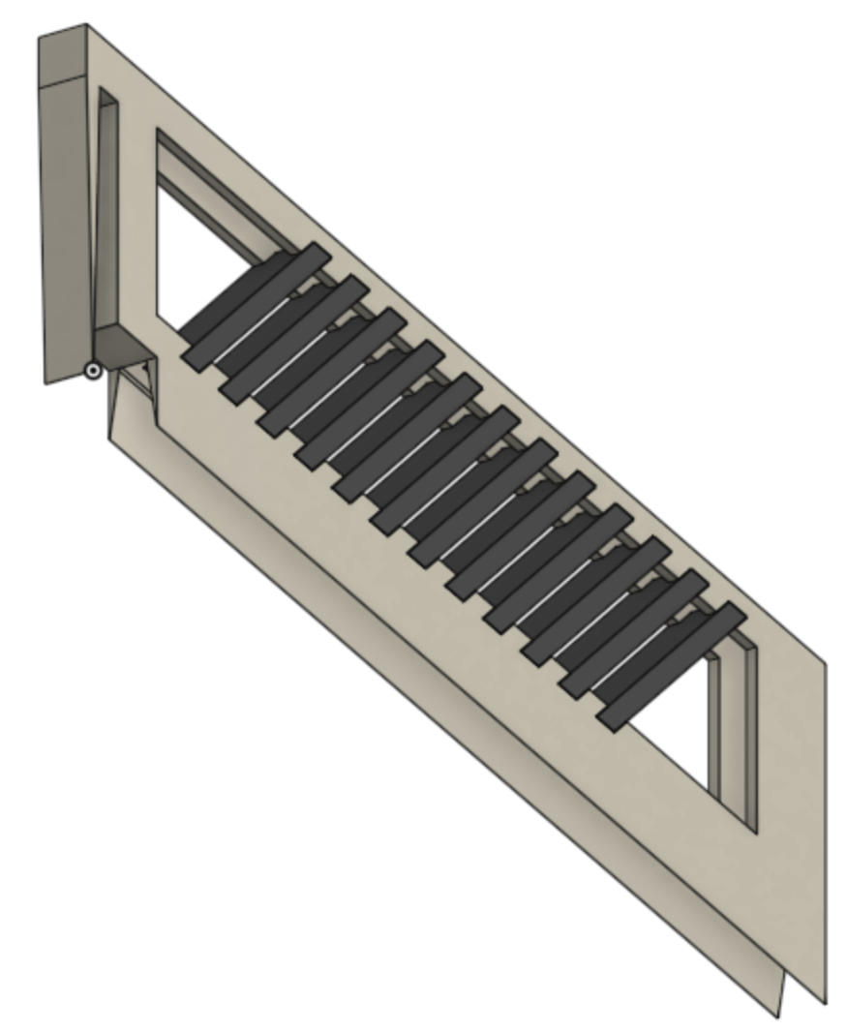
Designing and Testing
Testing without opening the tank
Module-oriented design
Minimizing the unwanted effects on flow
Proof of concept
Figure 6: Top Isometric
View of Model
Figure 7: Bottom Isometric
View of Model
Figure 8: Bottom View of Model
HRS: Plate Settlers | Research | Symposiums Presentation Spring 2019

Slide 10
Questions
and
Recommendations
Carmen Ortega
co276@cornell.edu
Civil Engineering
Leena Sen
lps57@cornell.edu
Earth and Atmospheric Sciences
Luke Meyer
lcm227@cornell.edu
Environmental Engineering
HRS: Plate Settlers | Research | Symposiums Spring 2019
Notes:
And with that, does anyone have any questions or comments?

Slide 11
Appendix
Slides
HRS: Plate Settlers | Research | Symposiums Presentation 2019
Notes:
From this point on, add any slides with figures that will help support your thesis. You might pull these figures from your Final Report.

Slide 12
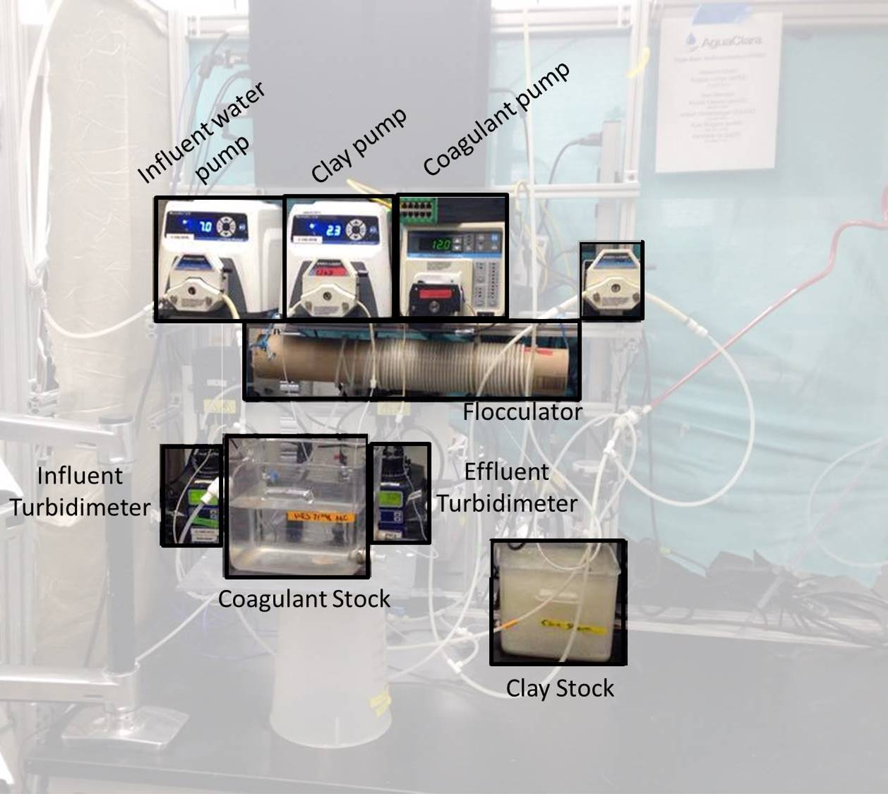
Lab Bench Set-Up
High Rate Sedimentation | Research | Symposium Spring 2019
Notes:
Figure 8: The overall location and proximity of experimental lab bench set up

Slide 13


Floc Blanket Formation (x60 Speed)
Notes:
The video shown is a sped up film of the floc blanket formation over a 1 hour period of time. The water is moving up the sedimentation tank. The floc blanket can be seen forming near the intersection of the floc weir and the recirculator. Excess flocs are drained through the floc weir. As was mentioned in the previous slide, the objective of Experiment 1 was to determine whether or not the decay of the floc blanket could be decreased by increasing the coagulant dose (in order to compensate for the floc accumulation on the tubing walls).

Slide 14
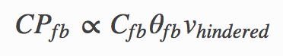
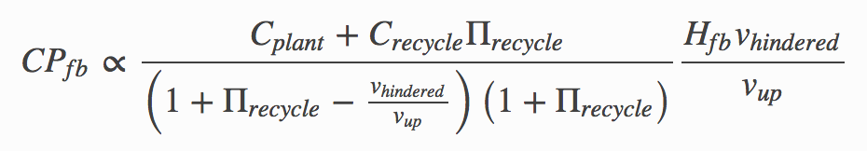
Expression for Collision Potential
High Rate Sedimentation | Research | Symposium Spring 2019
Notes:
The first expression states that the collision potential is proportional to the concentration of the floc blanket, the residence time of flocs in the floc blanket, and the hindered sedimentation velocity of those flocs. The full expression is derived from this original equation.
The expression for Cfb was derived from a mass balance on the floc blanket. The hydraulic residence time was derived to be the height of the floc blanket divided by the velocity of the floc blanket
https://aguaclara.github.io/Textbook/Sedimentation/Sed_Theory_and_Future_Work.html

